Slide 1
A.4 ASCII Encoding – May 03
Agenda
Stepwise Coding Approach
Discussion / Example
Module A.4 Encryption Methods
Complete Level 1 & 2 (Wednesday)
Complete Level 3 – Coding Program
Marks Spreadsheet
Submit All Work (Completed & Partially Completed)
Upcoming
Monday: Binary Numbers & Computer Memory

Slide 2
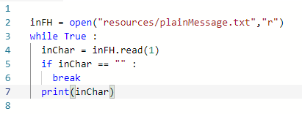
Stepwise Coding Approach
Start Simple
Begin With Something You Know

Slide 3
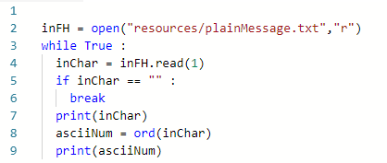
Stepwise Coding Approach
Add Things In Small Steps
Make a small change to see what works
If it doesn't work; You know where the problem is
New Code

Slide 4
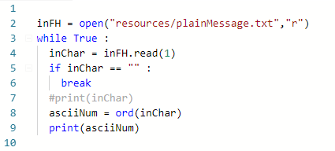
Stepwise Coding Approach
Use Comments (#) As You Go
To Temporarily "delete" code lines
To help remember "where you have been"
Commented Code

Slide 5
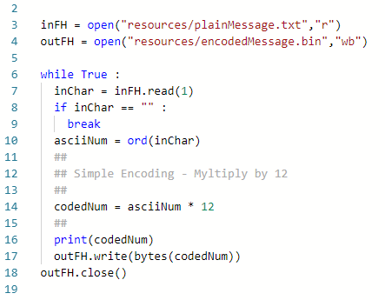
Coding Program Sample

Slide 6
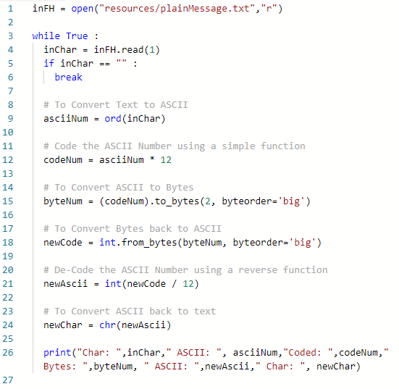
Binary Conversions Sample

Slide 7
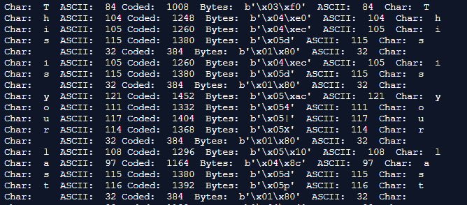
Binary Conversions Output

